Slide 1

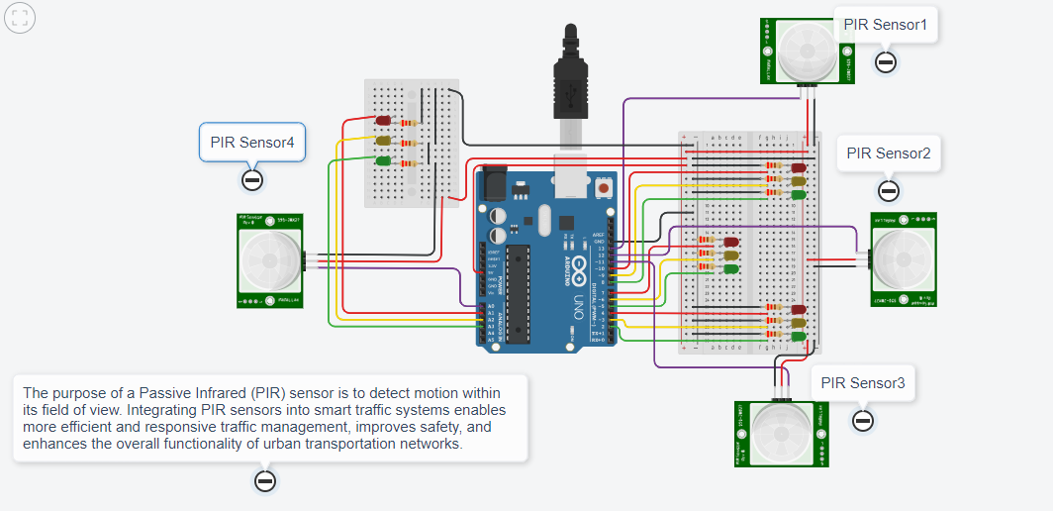
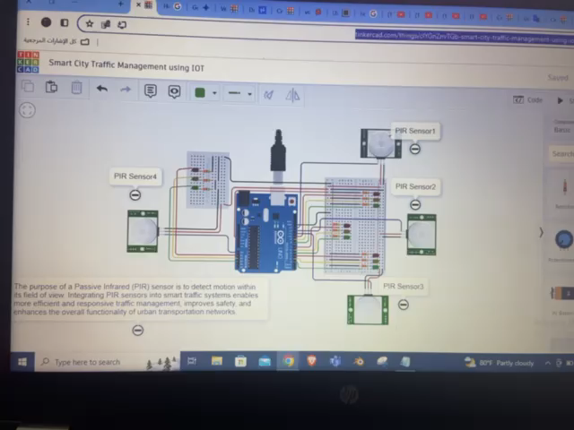
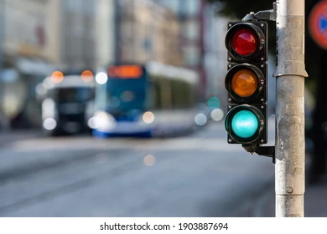
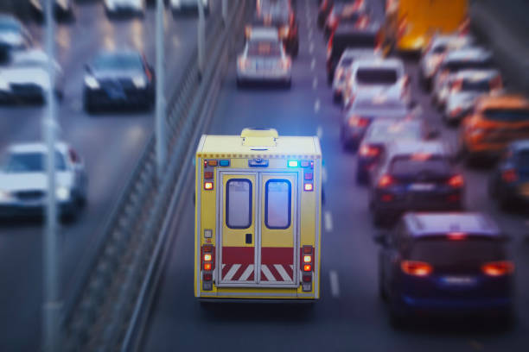

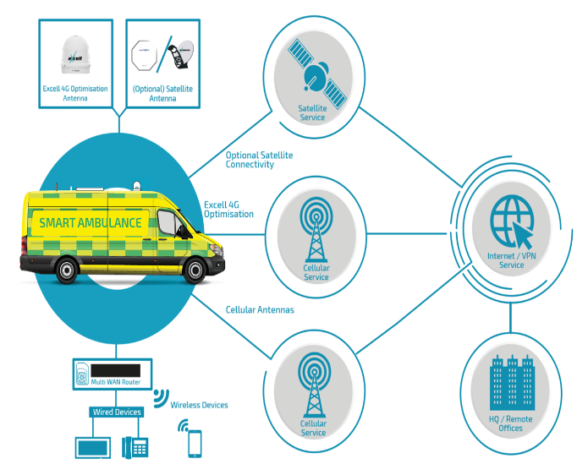
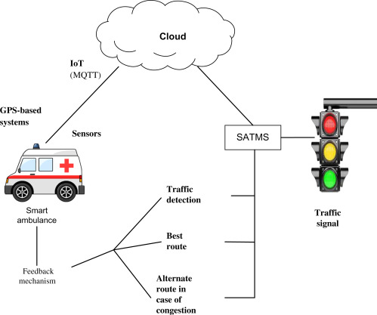

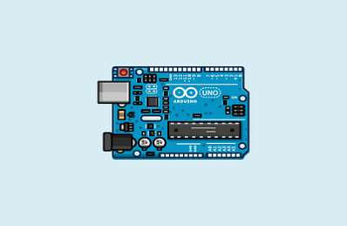
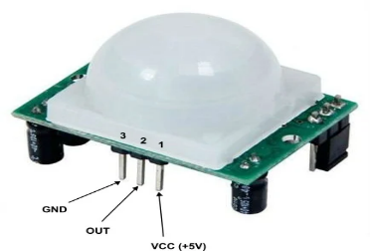

Analysis and Tools
Advantage and Drawbacks
Problem Statement
Reference
Critical Success Factors
Project Demo
Proposed Solution
The controller find the nearest ambulance to the accident and also the shortest path between the ambulance , accident spot and the nearest hospital .then he send this path to ambulance using this information the controller control all traffic signals in ambulance path which insure that the ambulance reaches the hospital without delay . The ambulance unit will turn ON the RF transmitter to communicate with traffic section.
Advantages :
Data-Driven Decision Making.
Resource Optimization.
Improved Communication.
Faster Response Times.
Drawbacks :
Reliance on Technology : Any technical malfunctions or system failures could potentially disrupt emergency medical services delivery.
Cost of Implementation.
Data Privacy and Security Risks.
Integration Challenges.
Traffic congestion occurs due to traffic signal. At traffic signal when road traffic density is low signal still shows the same traffic time due to which other lane traffic increases which result in traffic congestion. Sometimes due this problem the ambulance, police vans, fire-fighting vehicle are not reaching at their destination on time.
In order to save human life , we introduce new system called : smart ambulance using intelligent traffic control system. Which will control the timing of the traffic light in the path of emergency vehicle. This system will be installed in the traffic signals integrated with Smart ambulance system along with the GPS this can solve the problems caused due to traffic congestion.
Lives Saved: By reducing response times and enhancing patient care, the Smart Ambulance System has the potential to save lives, particularly in critical medical emergencies where every minute counts.
Technology Reliability: Ensuring the robustness and reliability of the technology infrastructure supporting the Smart Ambulance System is critical to its success, including GPS tracking, communication systems, and medical equipment.
Faster Response Times: By utilizing real-time traffic data, GPS tracking, and intelligent routing algorithms, the Smart Ambulance System optimizes ambulance routes to reach emergency scenes swiftly, reducing response times and potentially saving lives.
Smart ambulance : traffic management
Component Used :
Arduino Uno.
LEDs.
Power Supply 5V DC.
PIR Sensor.
Software Used :
Arduino IDE.
Python IDLE.
Tinkercard.
Taiba Saleh Al Araimi
Sheikha Raid Al Ruzaiqi
Rawdah Mohammed Al Shamsi
Ahlam Ali Al Sheheimi
Nasser Ali Al Sadi
link:
https://www.tinkercad.com/things/clYGnZnvTGb-smart-city-traffic-management-using-iot-/editel
https://github.com/AhlamBest/Smart-Ambulance---Traffic-Management-Group3.git

